Slide 1



Data Science Methods for Cutting-edge Tech
Knowledge and solutions for a changing world
Advancing data-intensive discovery in all fields
Be boundless
UW DIRECT
(Métodos de ciencia de datos para tecnología de punta)
https://uwdirect.github.io
Chad Curtis (ccurtis7)
Chemical Engineering
David A. C. Beck (dacb)
Chemical Engineering & eScience Institute

Slide 2
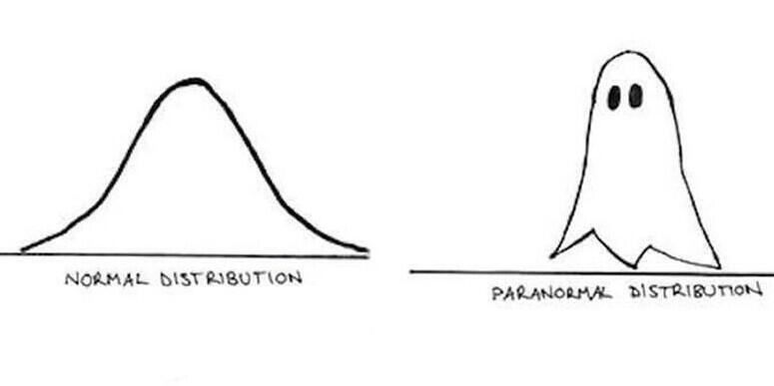
Some serious stuff
Notes:
https://blog.enotes.com/2015/04/30/10-extra-cheesy-math-jokes-explained/
Explain random-ness with the height of people in Seattle.
Or a really really bad scale.

Slide 3
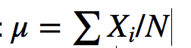
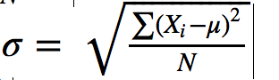
Review
Mean and s.d. of a population
Nature, 2013. Importance of being uncertain.

Slide 4
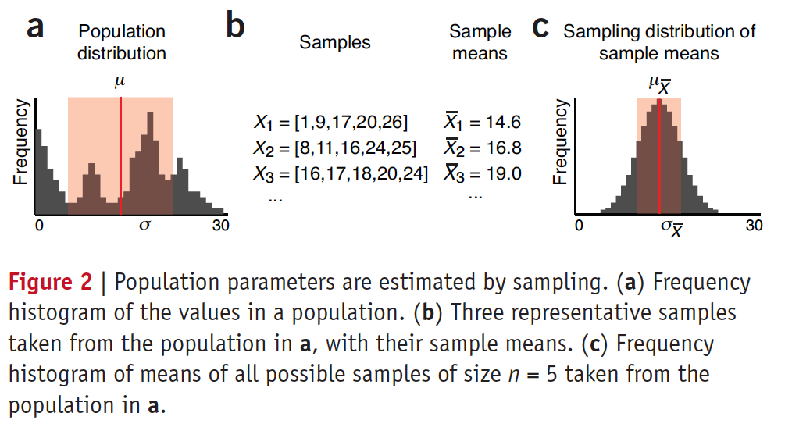
Review
Nature, 2013. Importance of being uncertain.

Slide 5
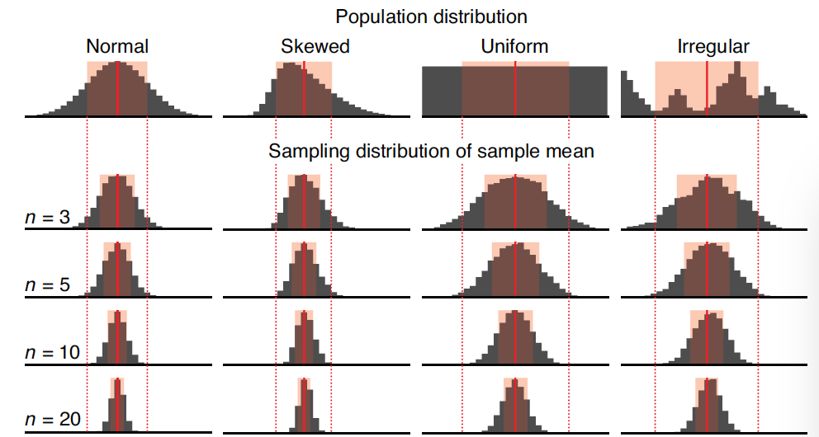
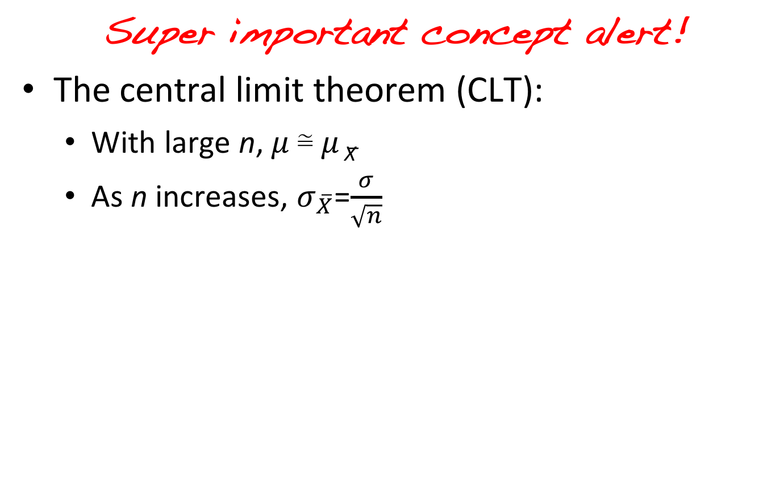
Review
Super important concept alert!
The central limit theorem (CLT):
With large n, 𝜇 ≅ 𝜇 _{X̅}
As n increases, $σ_{\overline{X}}$=$\frac{σ}{\sqrt{n}}$
Nature, 2013. Importance of being uncertain.

Slide 6
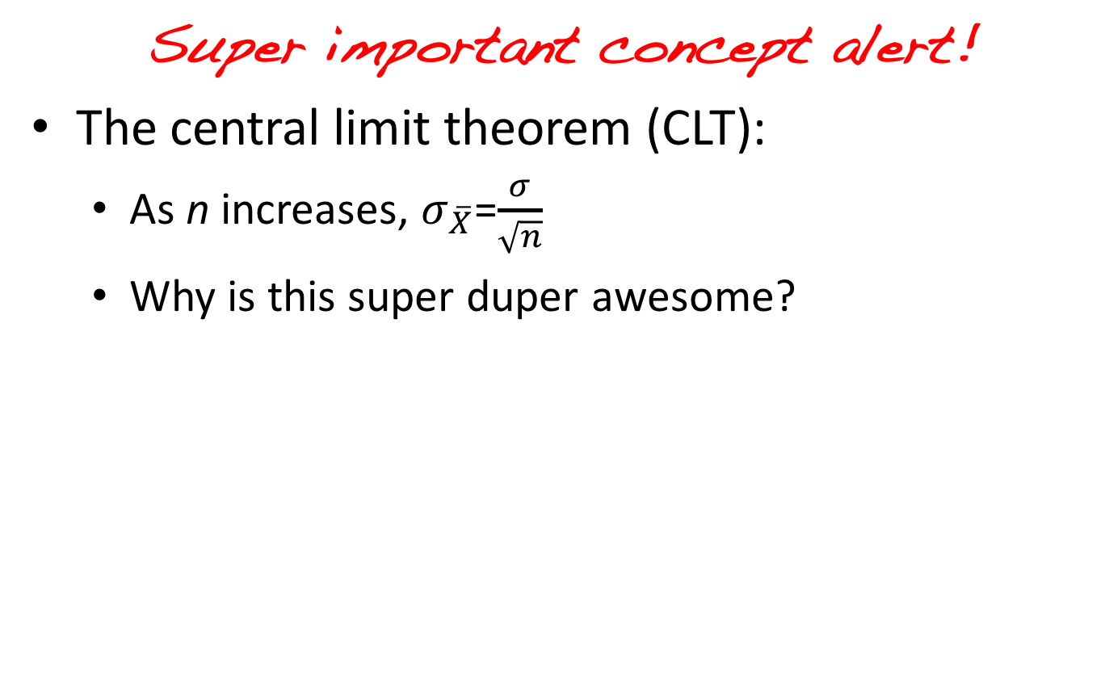
Review
Super important concept alert!
The central limit theorem (CLT):
As n increases, $σ_{\overline{X}}$=$\frac{σ}{\sqrt{n}}$
Why is this super duper awesome?
Nature, 2013. Importance of being uncertain.

Slide 7
Review
What did you observe with your Jupyter notebook experiments in last class?
Did the sample mean converge on the population mean?
Did the sample mean s.d. converge on the population s.d. divided by square root of n?

Slide 8
Today…
Continuous vs Discrete random variables
Common distributions and their uses
Sampling from distributions
Hacky-hack time!

Slide 9
Continuous vs Discrete
A continuous random variable can take any value, bounded or not.
Some examples?
You measure the weight of a new hydroscopic substance you have developed hourly for a week.
What units are you using for weight?

Slide 10
Continuous vs Discrete
A discrete random variable can only take certain values, e.g. integers.
Some examples?
Flip a count n times and count the number of heads. What is n?
What is the range of values for the number of heads?
Can you get n/2 heads? n/3 heads?

Slide 11
Continuous vs Discrete
Discrete random variables have discrete probability distributions.
Continuous random variables have continuous probability distributions.
What is a probability distribution?

Slide 12
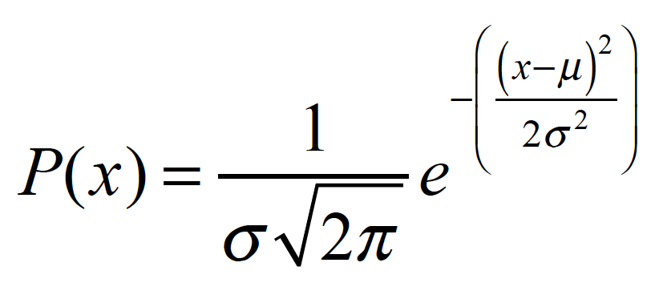
Probability distributions
For a given distribution, the probability distribution function P(X) is the probability of drawing the value X from the distribution.
P(X)
https://en.wikipedia.org/wiki/Normal_distribution

Slide 13
Probability distributions
For continuous random variables the probability distribution is usually called the probability density function (PDF).
For discrete random variables the probability distribution is usually called the probability mass function (PMF).
What could this be a PMF of?
http://tinyurl.com/yattghb7

Slide 14
Common discrete distributions
The binomial distribution
There are n independent trials
With binary outcomes, e.g. yes/no, success/failure, true/false
The probability of success doesn’t vary with trial
Example use case?
Notes:
Imagine a scenario in which you classify
hypothetical battery anodes as “success” or
“failure” on the basis of achieving a certain level
of sustained performance.

Slide 15
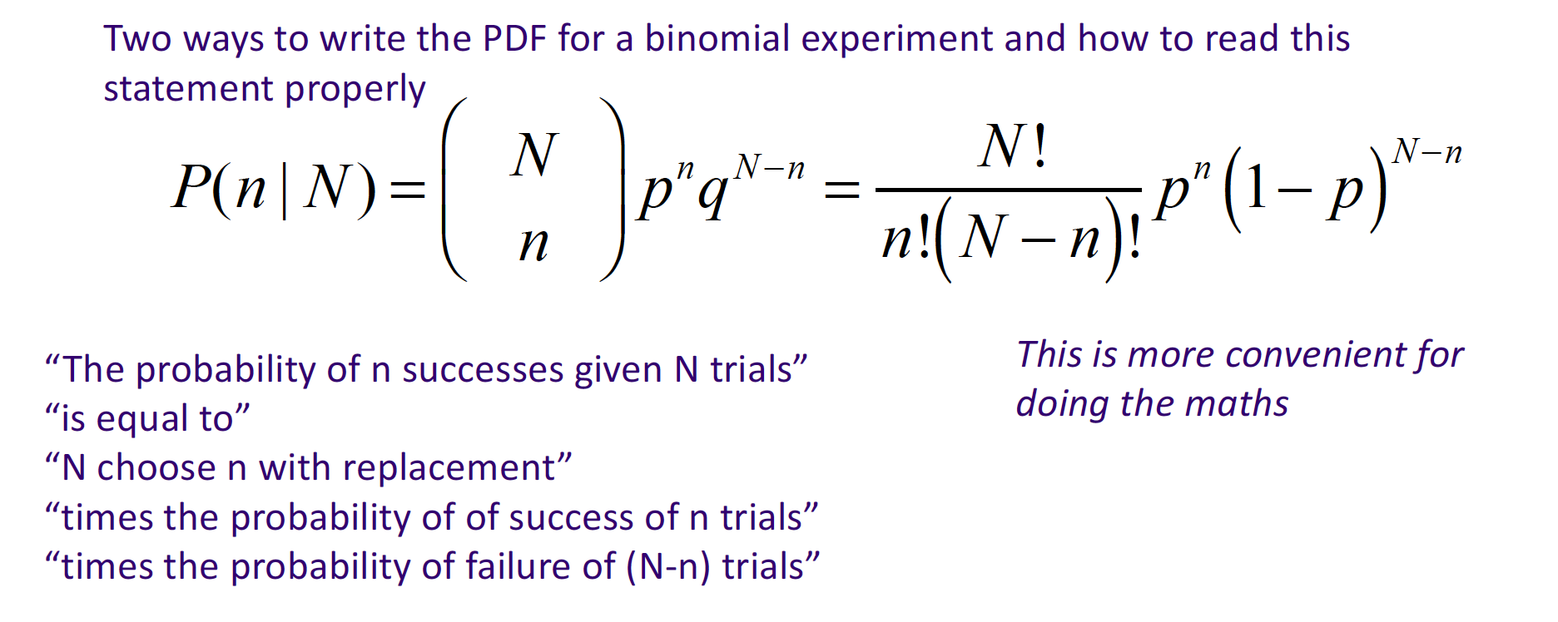
Common discrete distributions
The binomial distribution
Notes:
Imagine a scenario in which you classify
hypothetical battery anodes as “success” or
“failure” on the basis of achieving a certain level
of sustained performance.

Slide 16
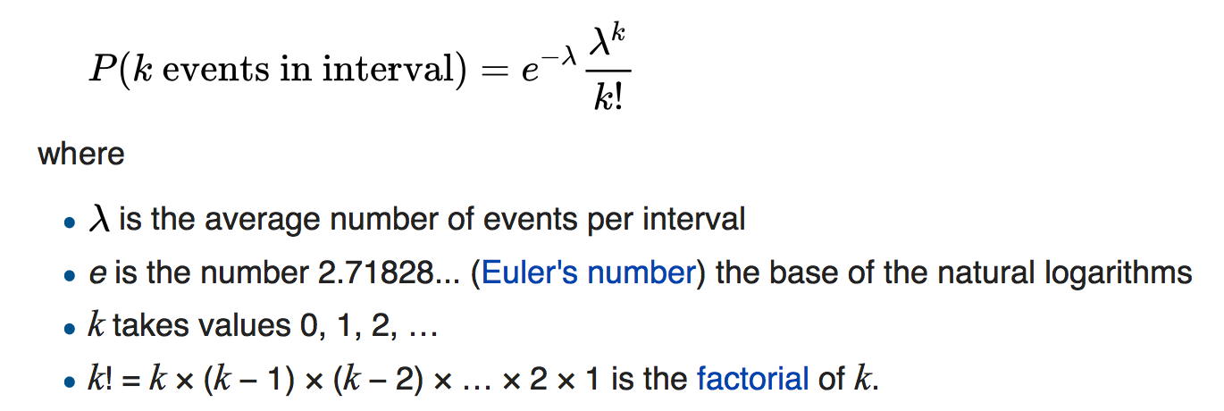
Common discrete distributions
The Poisson distribution
Discrete data over continuous intervals
For modelling the number of times an event occurs in an interval of time or space.
Assumptions:
Events occur independently
Rate at which events occur is constant

Slide 17
Common discrete distributions
The Poisson distribution
Applications?
Analogy from chemistry: Poisson statistics can be related to the turnover number and its likelihood in catalysis.
Analogy from materials science: Poisson statistics can be related to the frequency of defects in materials processing.
The Poisson distribution is the limit of the binomial distribution as N → infinity.

Slide 18
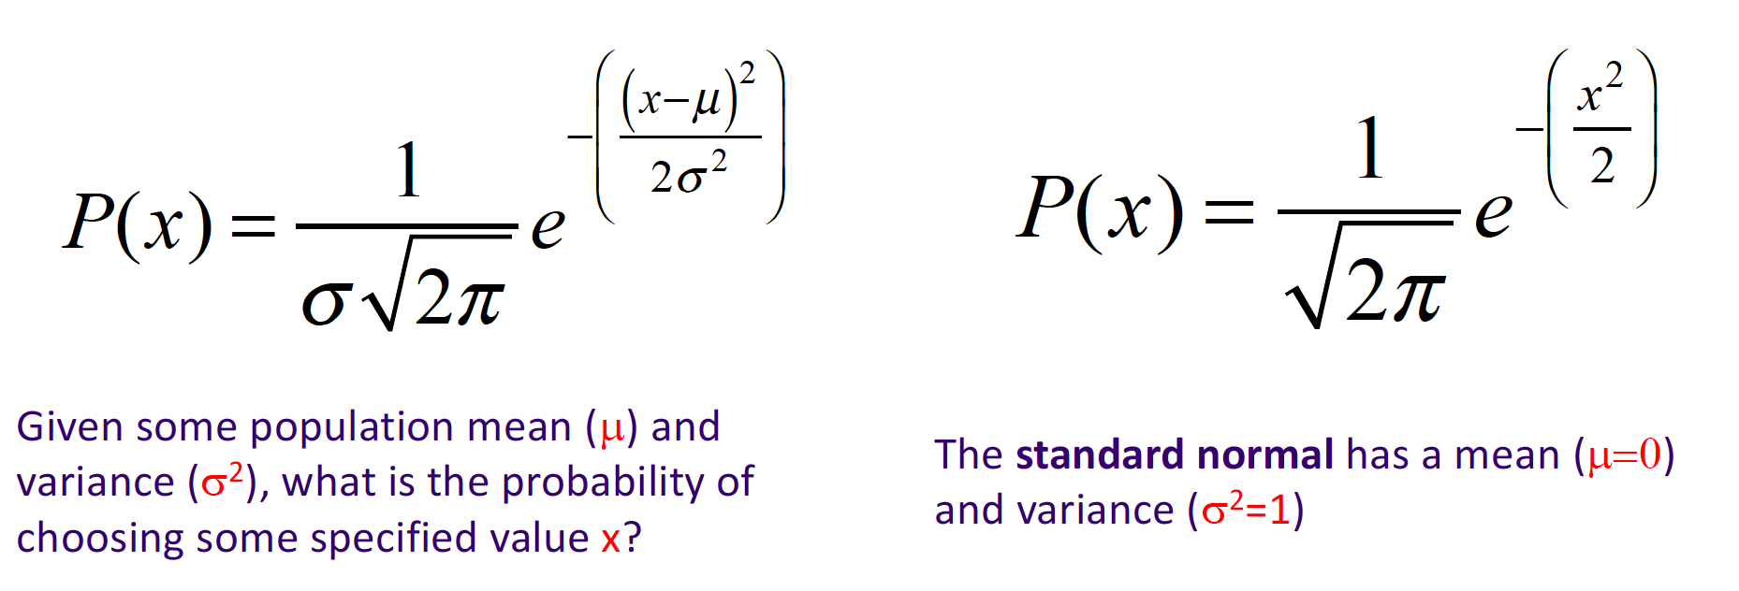
Common distributions
The normal distribution (or Gaussian)

Slide 19
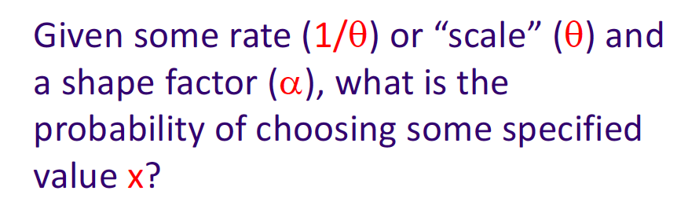
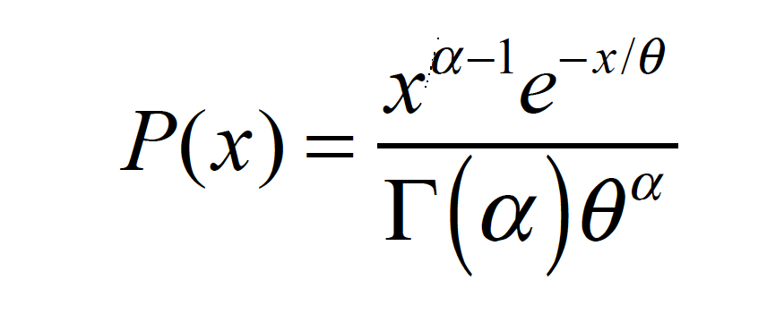
Common distributions
The gamma distribution
The variable we are collecting is the wait time between subsequent Poisson processes.
E.g. Consider a spectroscopic experiment that collects a set of single molecule data: individual times between chemical reactions (i.e., the inverse of a reaction rate)

Slide 20
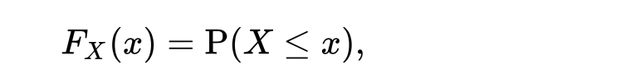
Cumulative distribution function (CDF)
PDF and PMF describe the probability of drawing a sample with a value X.
The cumulative distribution function (CDF) is the probability of drawing a value from the distribution less than x.

Slide 21
Cumulative distribution function (CDF)
Binomial distribution
PDF
CDF
https://en.wikipedia.org/wiki/Binomial_distribution

Slide 22
Cumulative distribution function (CDF)
Poisson distribution
PDF
CDF

Slide 23
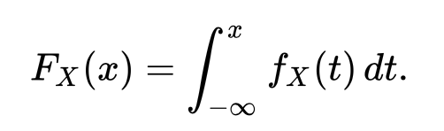
Cumulative distribution function (CDF)
For a continuous distribution, F(x) is the integral of the PDF.
PDF
CDF
https://en.wikipedia.org/wiki/Normal_distribution

Slide 24
Cumulative distribution function (CDF)
Why is the CDF useful?
E.g. survivability? What fraction of your mice are dead by day x?

Slide 25
Sampling from a distribution
Why is the CDF useful?
You can sample from a distribution using its CDF
Inverse transform sampling allows us to generate random samples according to a distribution
Recall F_{X}(x) is the CDF, the inverse therefore F_{X}⁻¹(x)
F(F⁻¹(u)) = u - inverse function
The range of F_{x}(x) is 0 to 1 (the cumulative probability)
Therefore the domain of F_{x}⁻¹(x) is 0 to 1

Slide 26
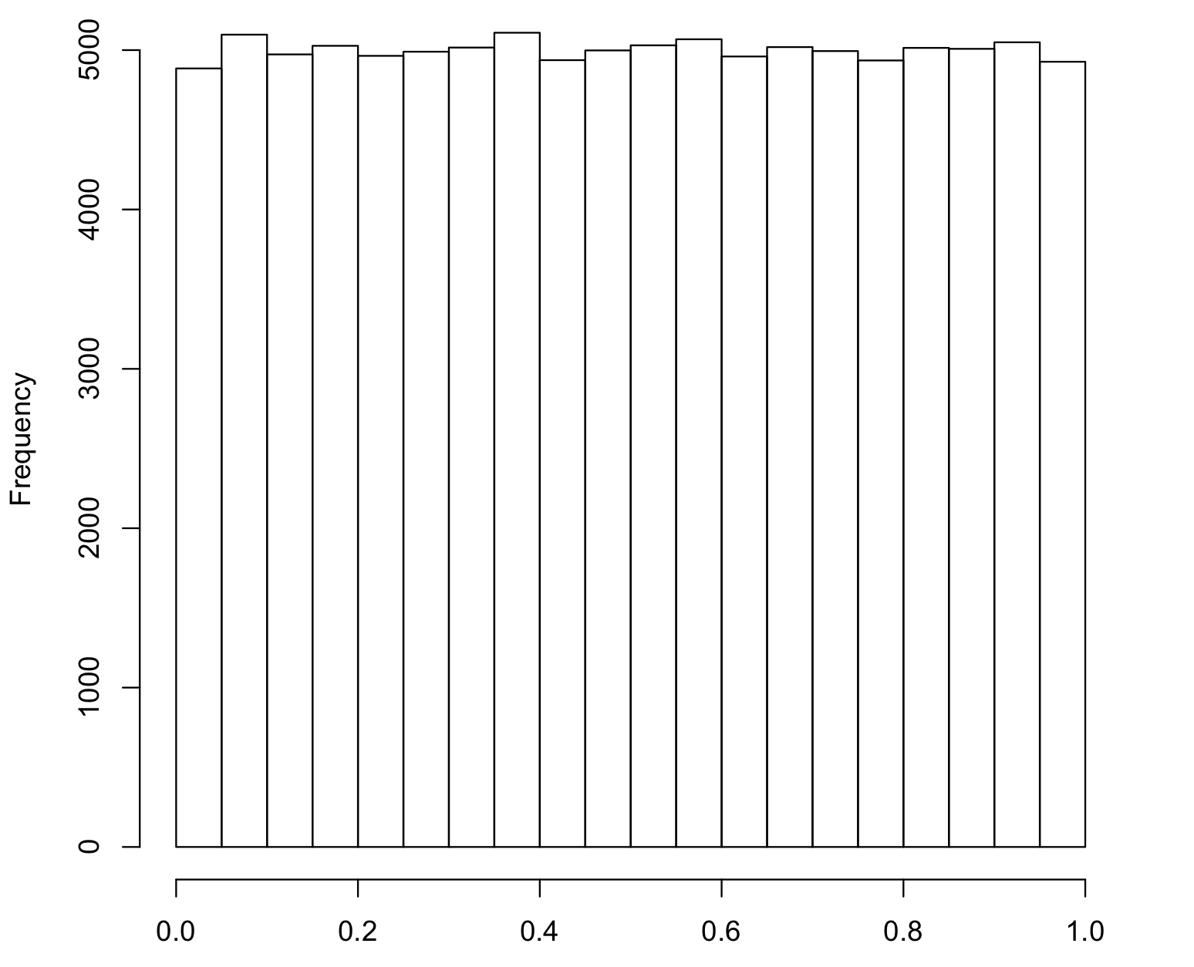
Sampling from a distribution
Why is the CDF useful?
You can sample from a distribution using its CDF
Generate a random number y from 0 to 1
All values between 0 and 1 have equal probability
(What distribution is this?)
Solve F_{x}⁻¹(y) to get a value from the distribution, x
uniform

Slide 27
Sampling from a distribution
Why is the CDF useful?
You can sample from a distribution using its CDF
F(F⁻¹(u)) = u - inverse function
For continuous distributions, an analytical solution for the inverse CDF is not always possible (including normal)

Slide 28
Hacky hack time!
To Jupyter notebook!
Create some P(x) plots
Create a CDF from an empirical distribution
What is an empirical distribution?
Use the inverse transform to sample from your CDF

